Slide 1



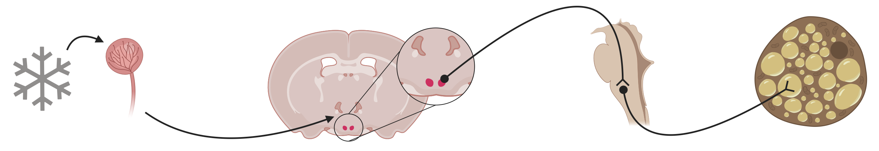

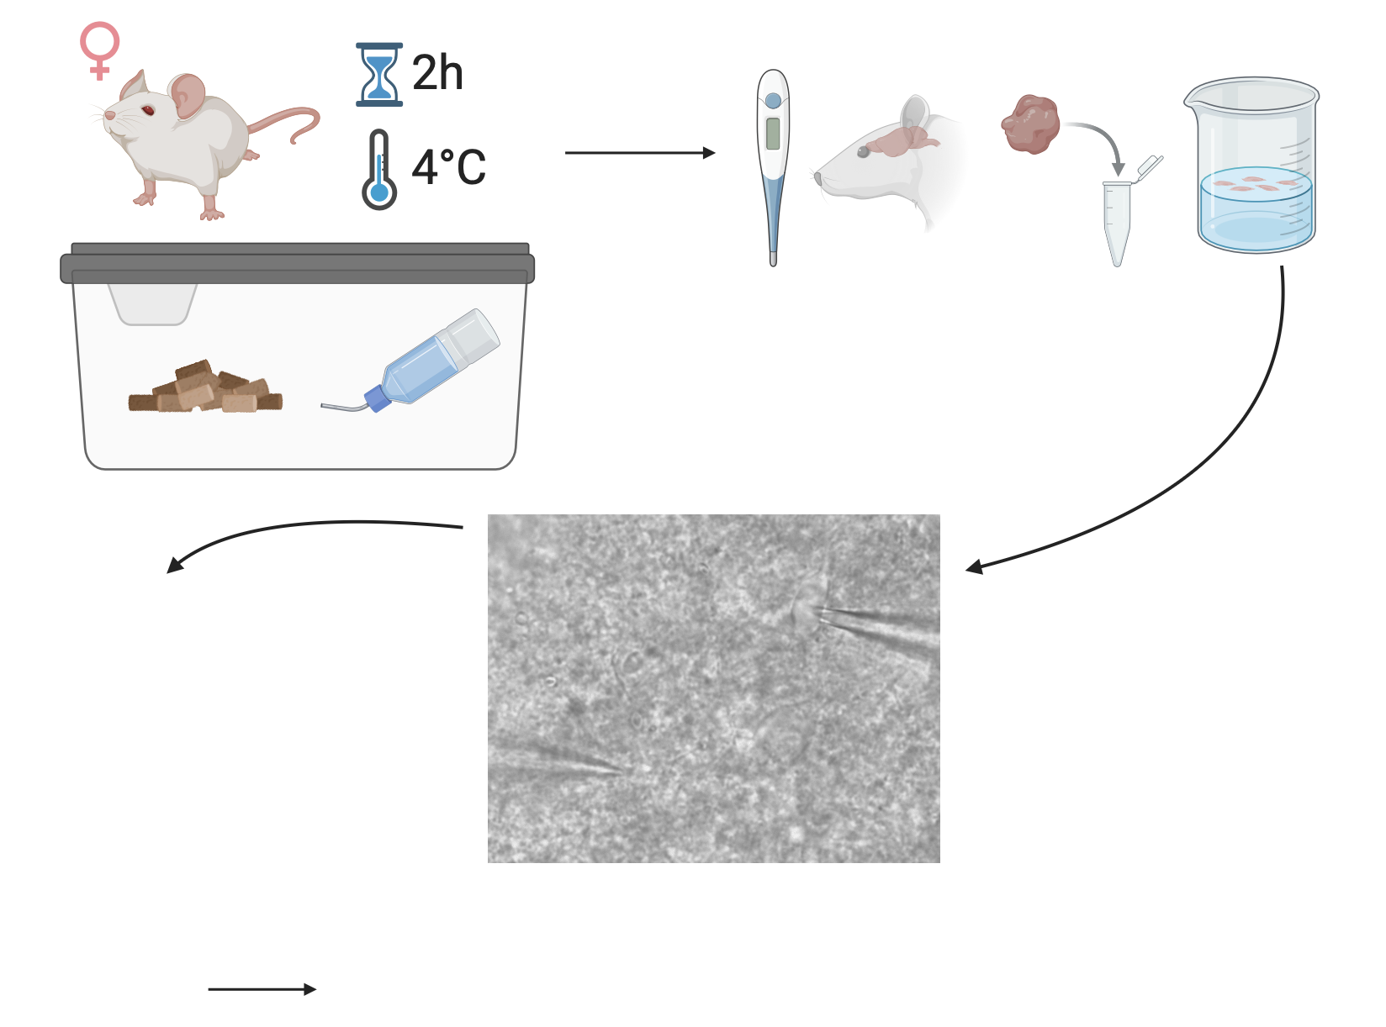
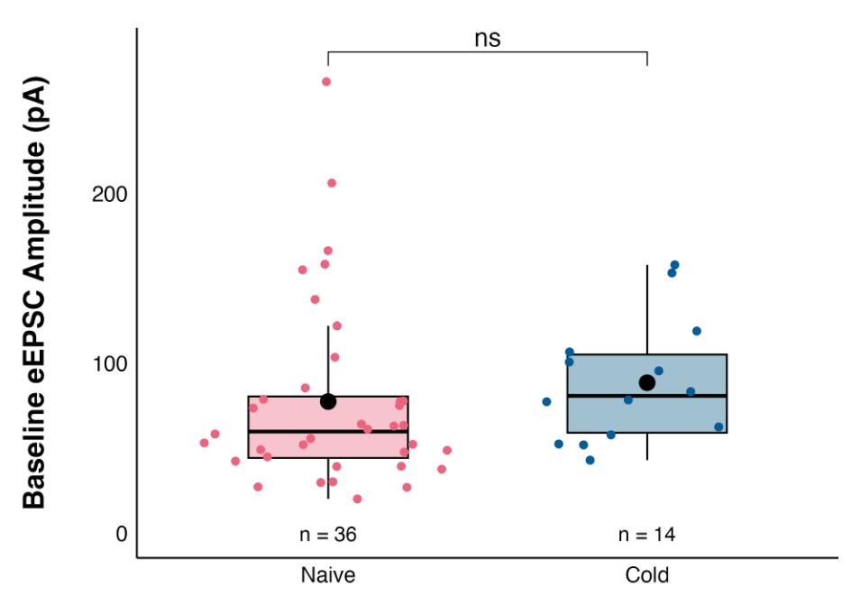
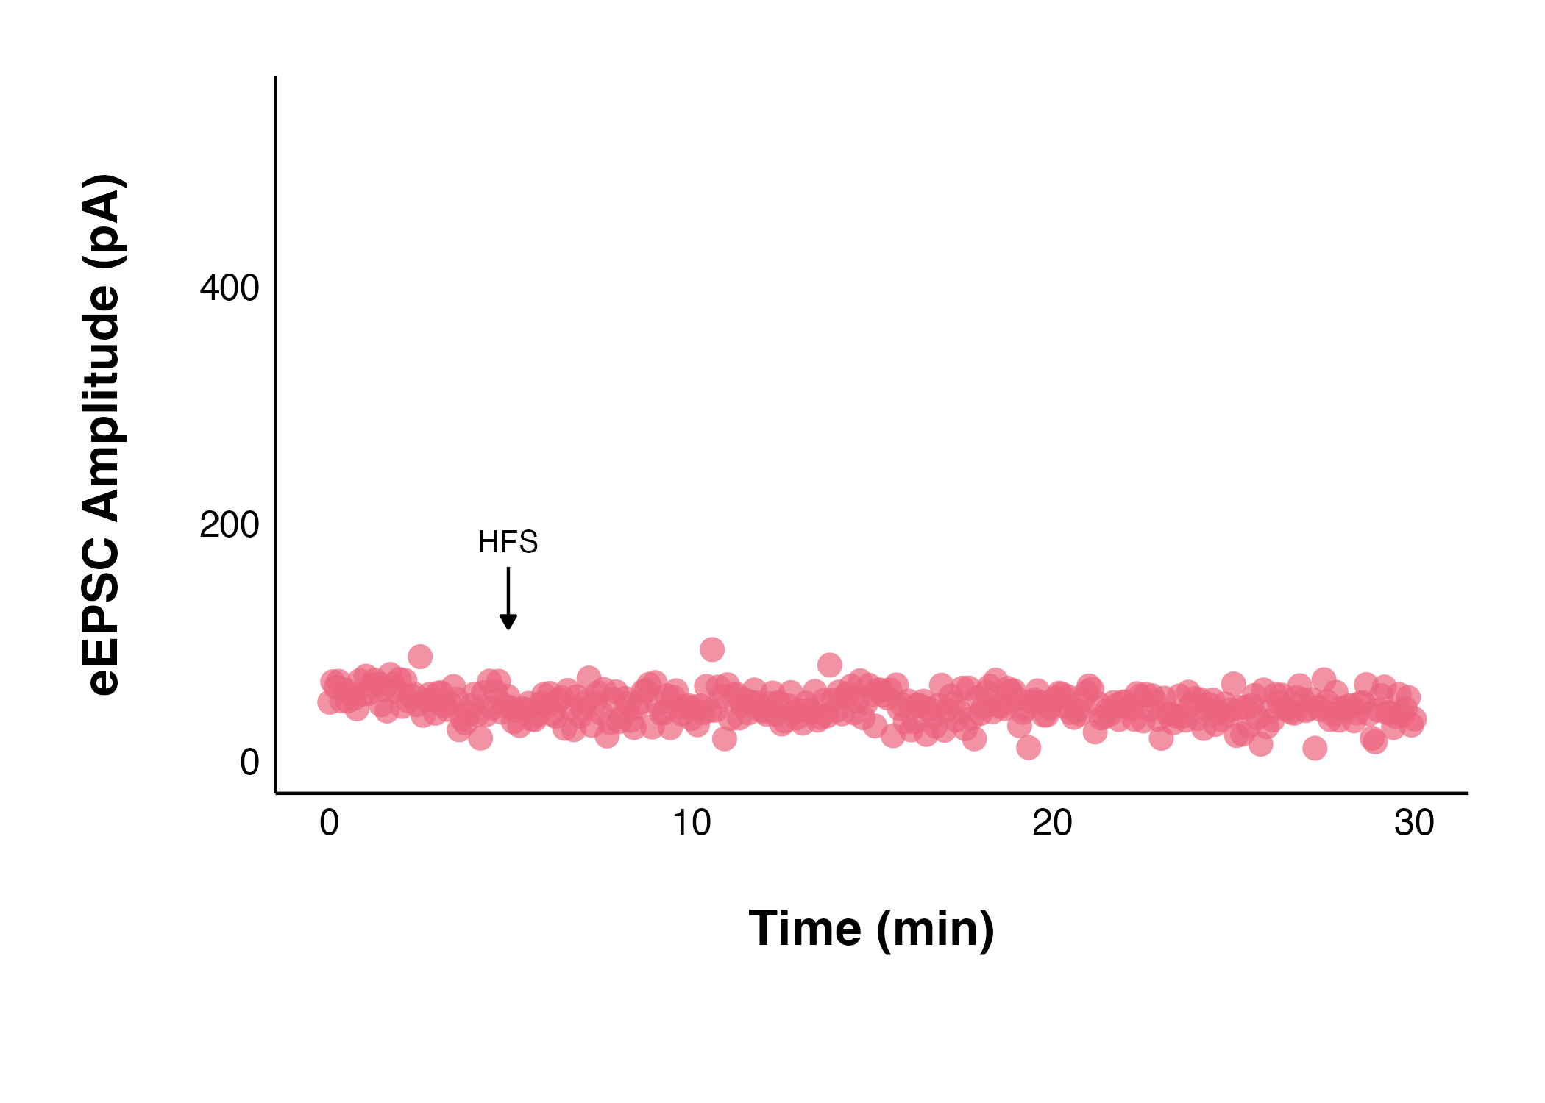
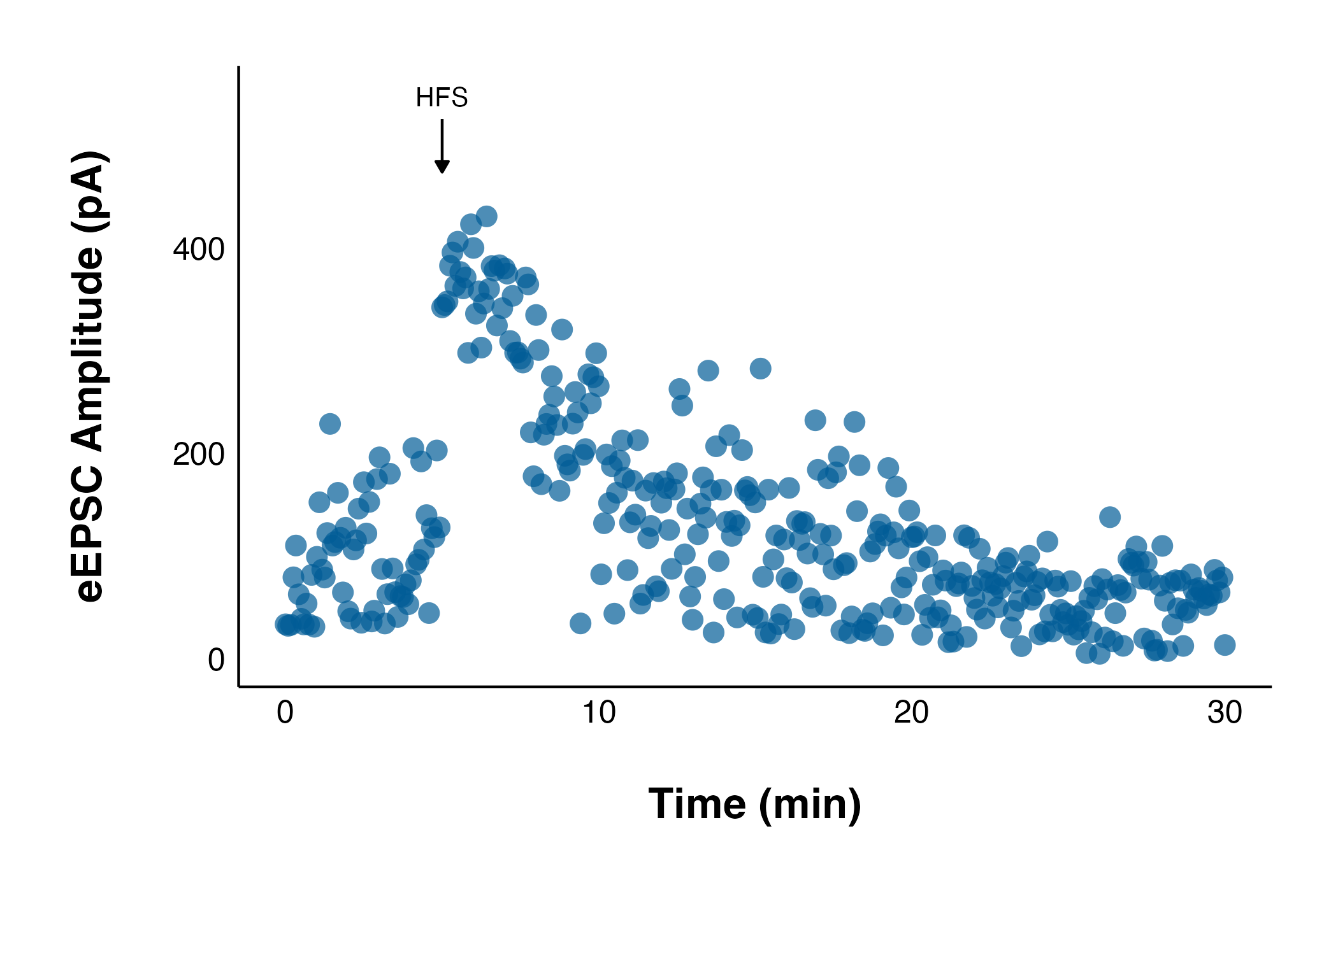
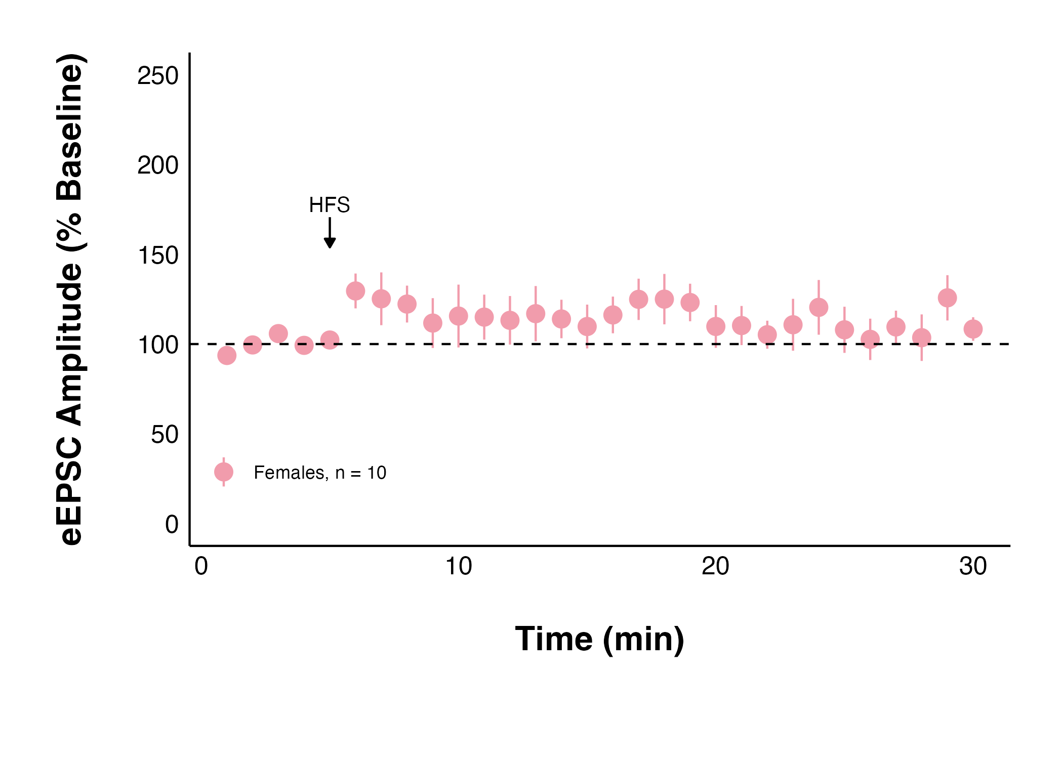
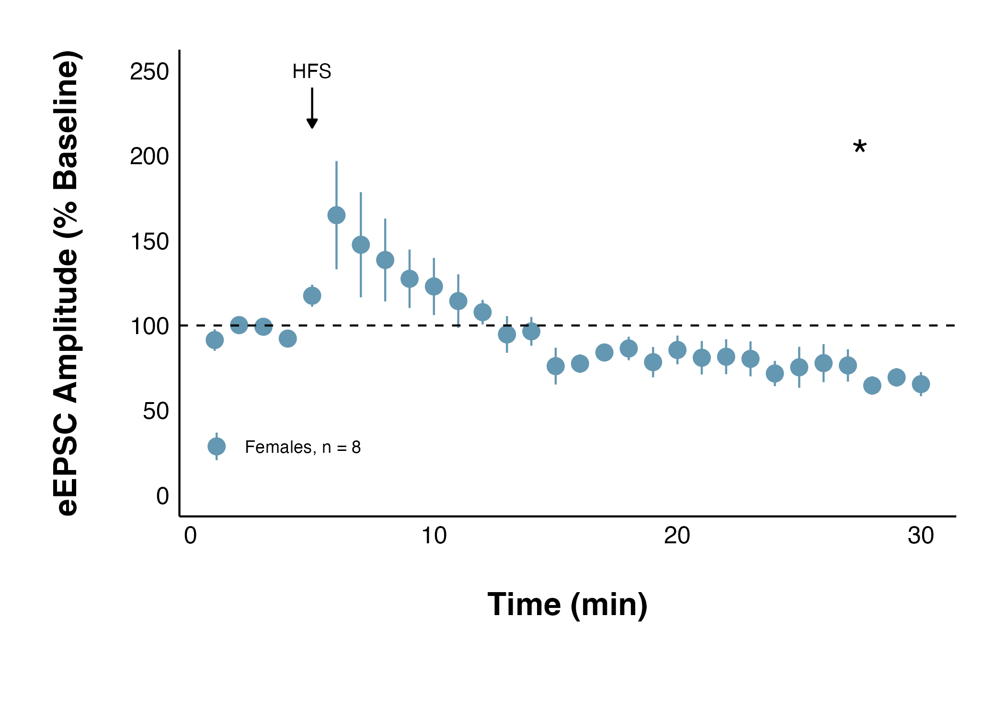
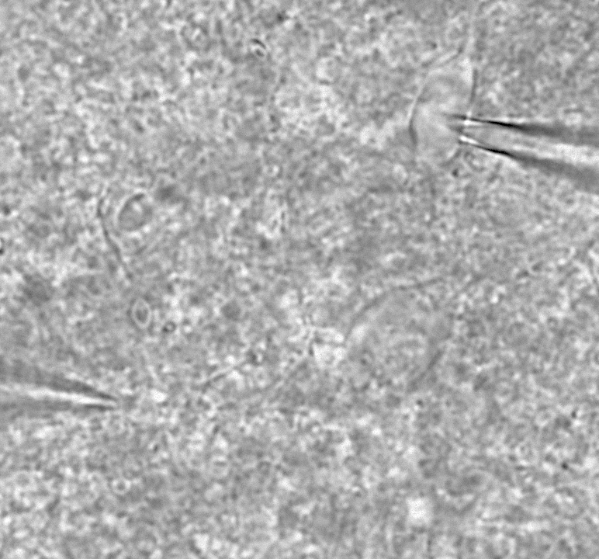
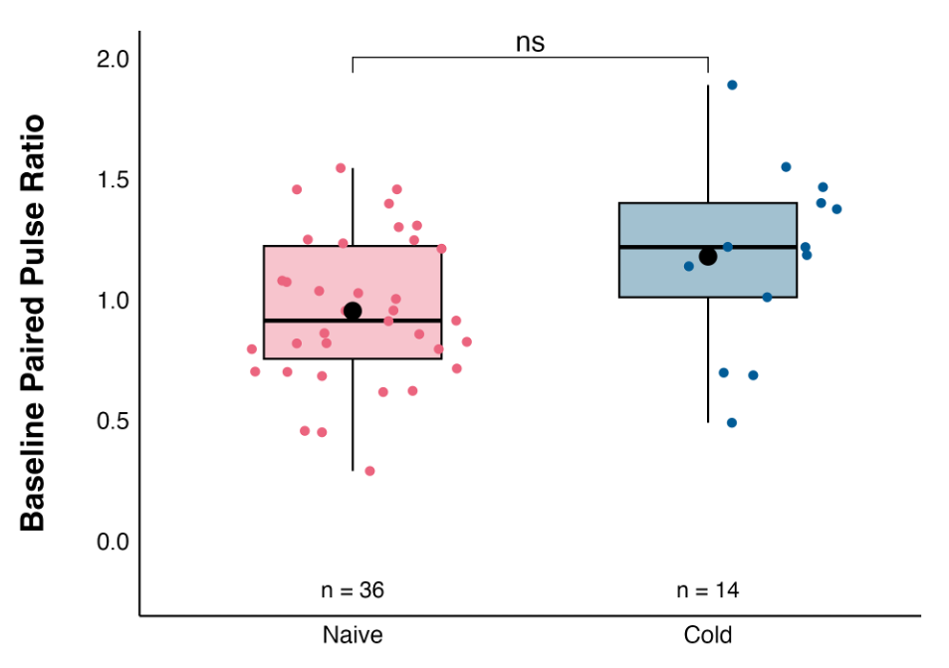
Acute Stress Decreases Neuronal Communication and Excitability in the Female Rat Dorsomedial Hypothalamus via Endocannabinoid-CB1 Receptor Signalling
Ruby Muzzatti, Dr Karen Crosby
Department of Biology, Mount Allison University, Sackville, New Brunswick, Canada
BACKGROUND
BAT thermogenesis is activated by inhibiting GABAergic or stimulating glutamatergic activity in the DMH⁴
Previous work by Truman Wood found that acute cold exposure in male rats:
Did not change core body temperature
Decreased baseline glutamate transmission (eEPSC)
Resulted in long-term depression in the strength of glutamate synapses
Thermoreceptors in the skin relay temperature information to the pre-optic area (POA) in the hypothalamus¹
DMH lesions impair thermoregulation under cold challenges³
Female rats may be more resilient to chronic cold exposure: they don’t experience the increased relative weight of adrenal glands, increased plasma corticosterone levels, or an effect on body weight, that male rats do⁵
The POA projects to the dorsomedial hypothalamus (DMH), a region involved in appetite regulation, metabolism, and fat storage²
DMH neurons project to the medulla, the primary site of sympathetic neurons that activate brown adipose tissue (BAT)¹
How acute cold exposure in females affects glutamatergic DMH neuronal activity and communication to ultimately influence BAT thermogenesis and metabolism is unknown
METHODS
All experiments were performed according to protocol #103088 approved by the
Mount Allison University Animal Care Committee in accordance with the
Canadian Council on Animal Care Guidelines
RESULTS
Acute cold exposure significantly decreased the
amplitude of evoked excitatory postsynaptic currents (eEPSC)
Acute cold exposure did not change baseline eEPSC amplitude or paired pulse ratio (PPR)
Young, female Sprague-Dawley rats were exposed to cold
They were anesthetized, euthanized, and their brains were quickly removed
Naive
Cold
Prior to brain removal, core body temperature was measured,
and immediately following brain removal, an interscapular BAT sample was collected
250 µm
coronal brain slices containing the DMH were kept alive in oxygenated artificial cerebrospinal fluid kept at 32.5 ℃
The PPR compares the amplitude of two evoked currents and is inversely proportional to the probability of neurotransmitter release
A recording electrode was inserted into DMH neurons, and a stimulating electrode into the surrounding tissue to evoke excitatory postsynaptic currents (eEPSC)
50 µM picrotoxin was applied to observe glutamate synapses
Living neurons were recorded from
before and after high frequency stimulation (HFS)
An independent t-test was used to compare the baseline parameters of the naïve and cold groups
Naïve female data was collected by Lara Swart and Emily Rushton
A paired t-test was used to compare each 5-minute interval to the 5-minute baseline period
* = p-value < 0.05
Data analysis was performed using patchclampplotteR by Christelinda Laureijs⁶
100 Hz for 4 seconds, repeated twice, 20 seconds apart
CONCLUSIONS
Future work aims to determine if:
The long-lasting depression is a result of the cold exposure or stress from the isolation, absence of bedding, and noise of the cold room (work in progress)
Brown adipose tissue activity is altered by cold exposure
REFRENCES
Schematic Images created using BioRender.
Labbé SM, Caron A, Lanfray D, Monge-Rofarello B, Bartness TJ, Richard D. Hypothalamic control of brown adipose tissue thermogenesis. Front Syst Neurosci. 2015;9. doi:10.3389/fnsys.2015.00150
Bellinger LL, Bernardis LL. The dorsomedial hypothalamic nucleus and its role in ingestive behavior and body weight regulation. Physiol & Behav. 2002;76(3):431-442. doi:10.1016/S0031-9384(02)00756-4
Almeida MC, Steiner AA, Branco LGS, Romanovsky AA. Neural Substrate of Cold-Seeking Behavior in Endotoxin Shock. Aballay A, ed. PLoS ONE. 2006;1(1):e1. doi:10.1371/journal.pone.0000001
Zaretskaia MV, Zaretsky DV, Shekhar A, DiMicco JA. Chemical stimulation of the dorsomedial hypothalamus evokes non-shivering thermogenesis in anesthetized rats. Brain Res. 2002;928(1-2):113-125. doi:10.1016/S0006-8993(01)03369-8
El Marzouki H, Aboussaleh Y, Najimi M, Chigr F, Ahami A. Effect of Cold Stress on Neurobehavioral and Physiological Parameters in Rats. Front Physiol. 2021;12. doi:10.3389/fphys.2021.660124
Laureijs C, patchclampplotteR: Plot and Analyze Raw Patch Clamp Electrophysiology Data [R Package]. Version 0.1.0. 2025.
ACKNOWLEDGMENTS
I want to thank and express my appreciation for Dr Crosby, for her training, time, and continued support and investment in me. Thank you to Christelinda and Emily for helping with data collection, Christelinda for all the help with my data analysis (and letting me be a tester for the R package!), and Jackie Jacob-Vogels for providing animal care. Finally, thank you to Hannah for listening to and talking with me about all things Mount Allison, biology, and research!
Cold exposure does not affect baseline synaptic transmission in the DMH of female rats (unlike the cold-induced decrease observed in males)
Cold exposure triggers a long-lasting depression of glutamate synapses in the DMH (as was observed in males)
Notes:
Working titles: Acute Stress Decreases Neuronal Communication and Excitability in the Female Rat Dorsomedial Hypothalamus via Endocannabinoid-CB1 Receptor Signalling

Slide 2
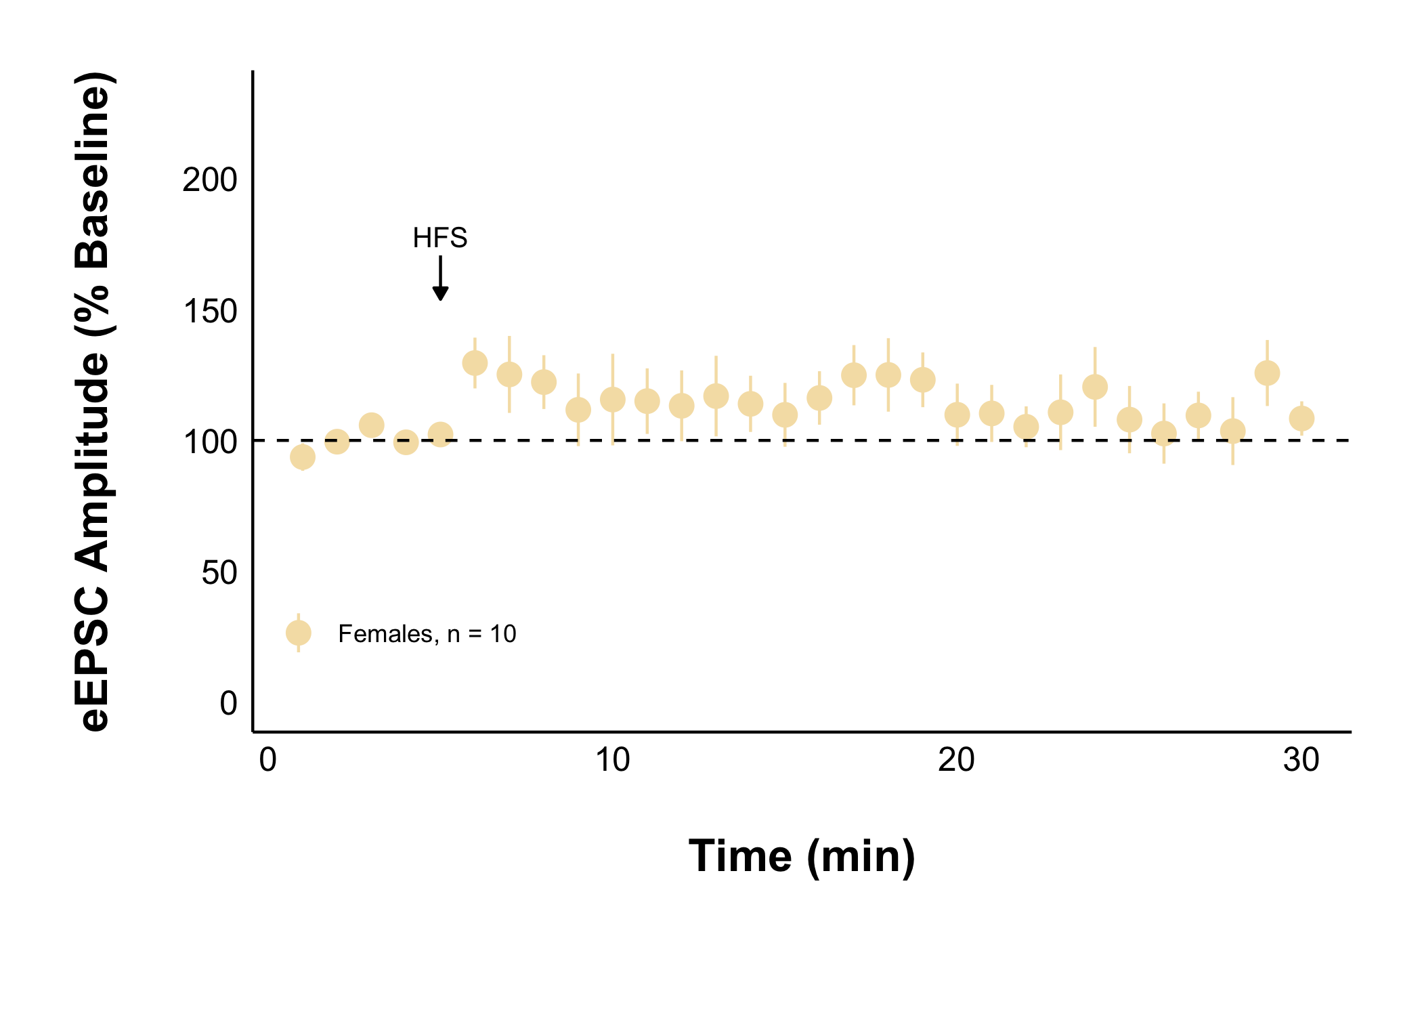
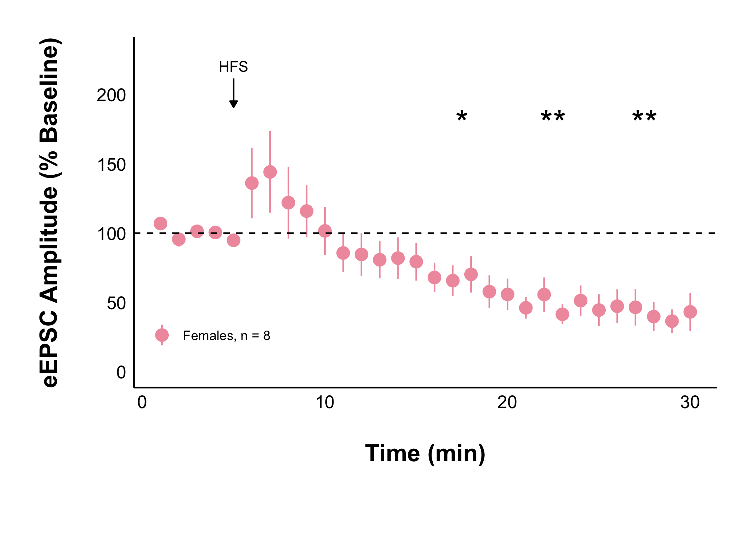
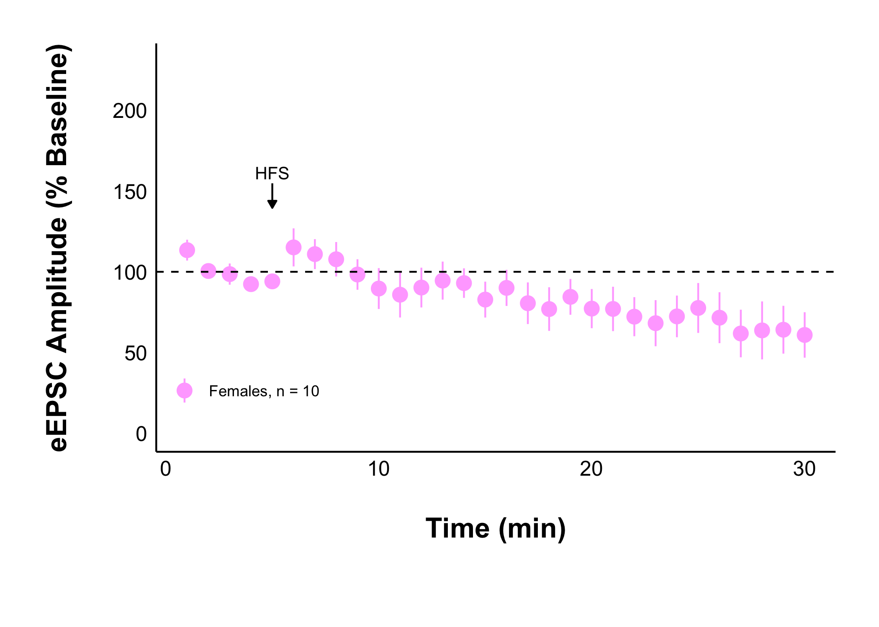
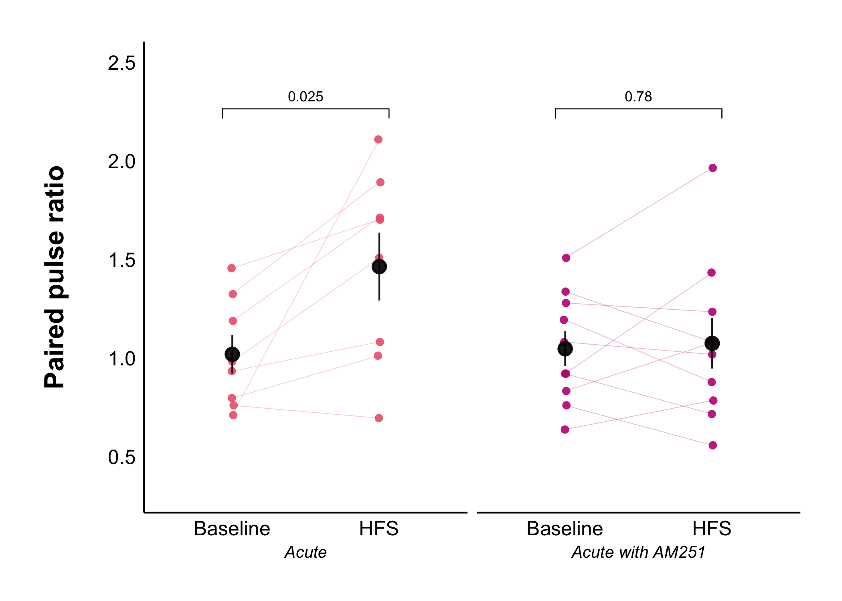
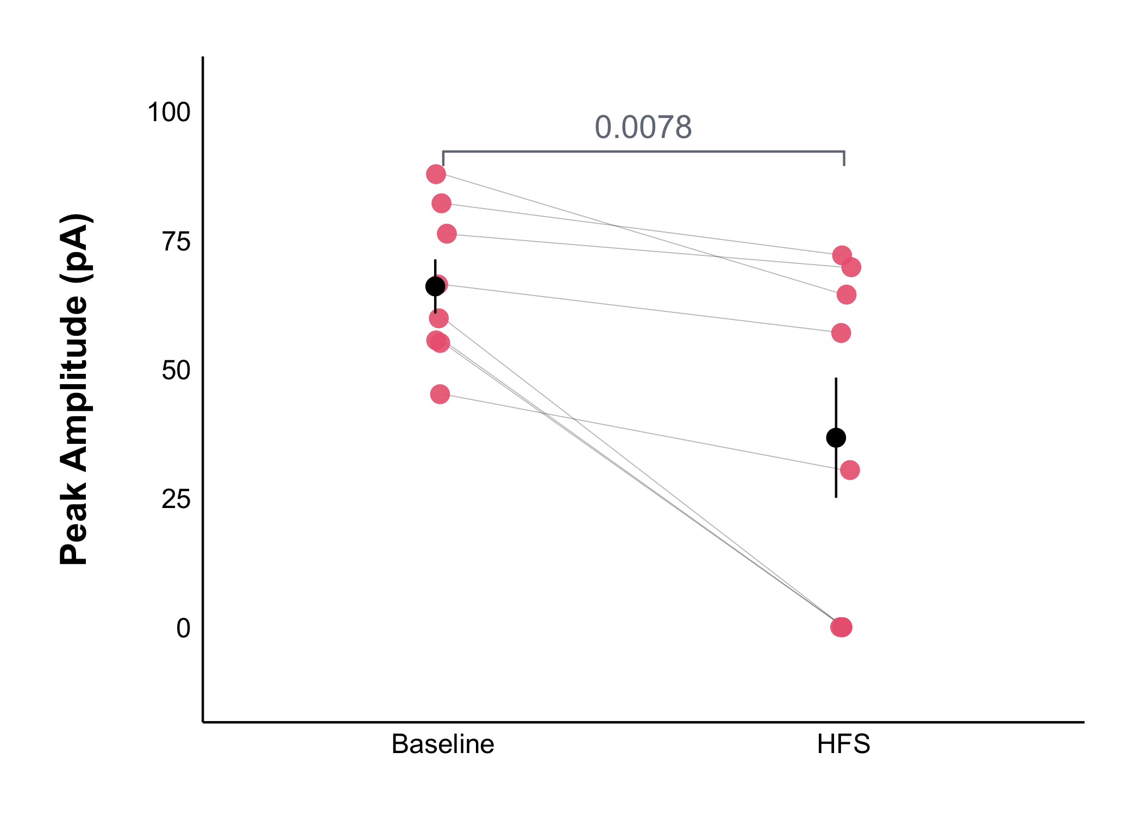
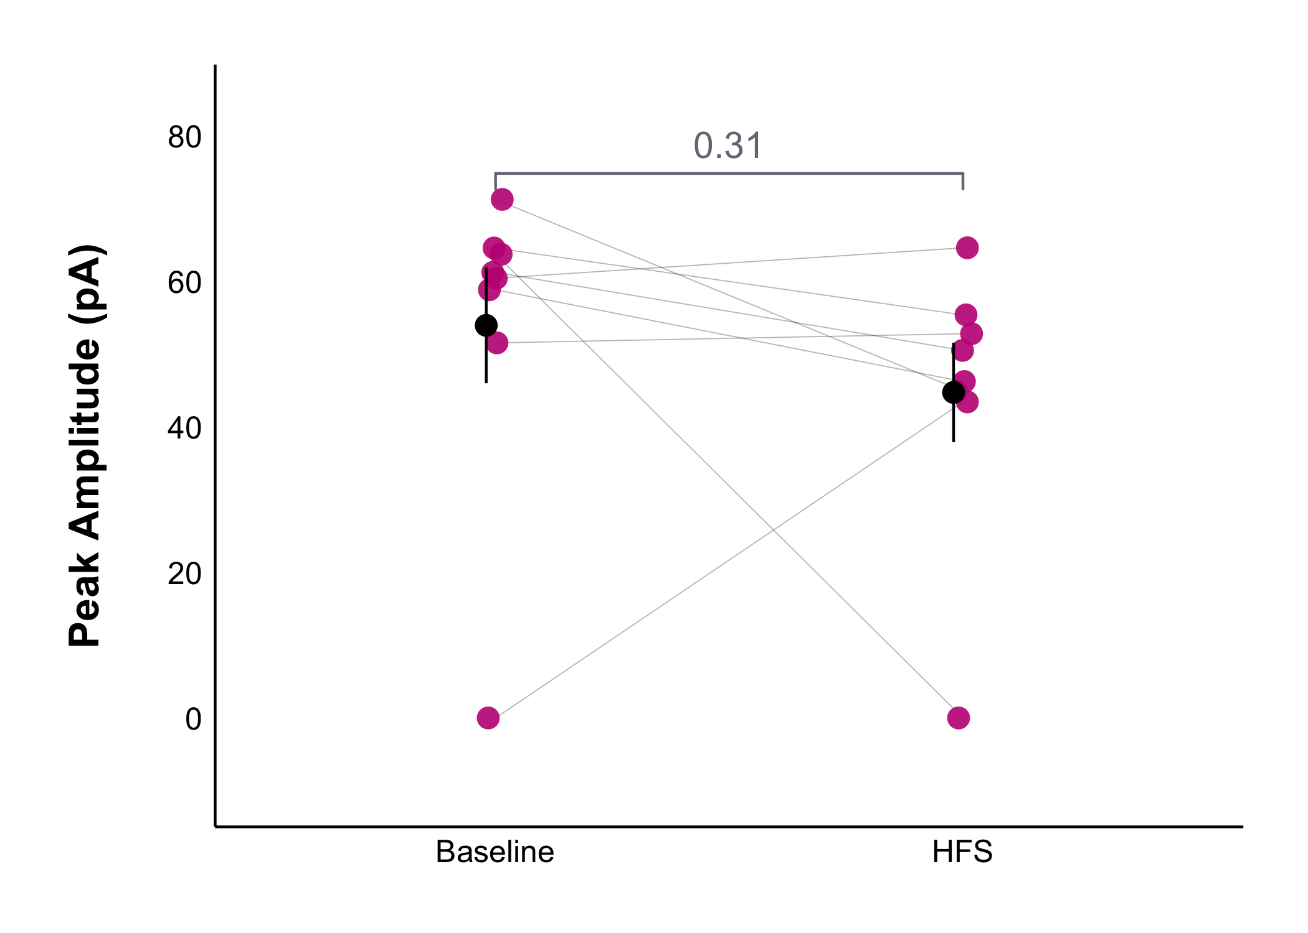
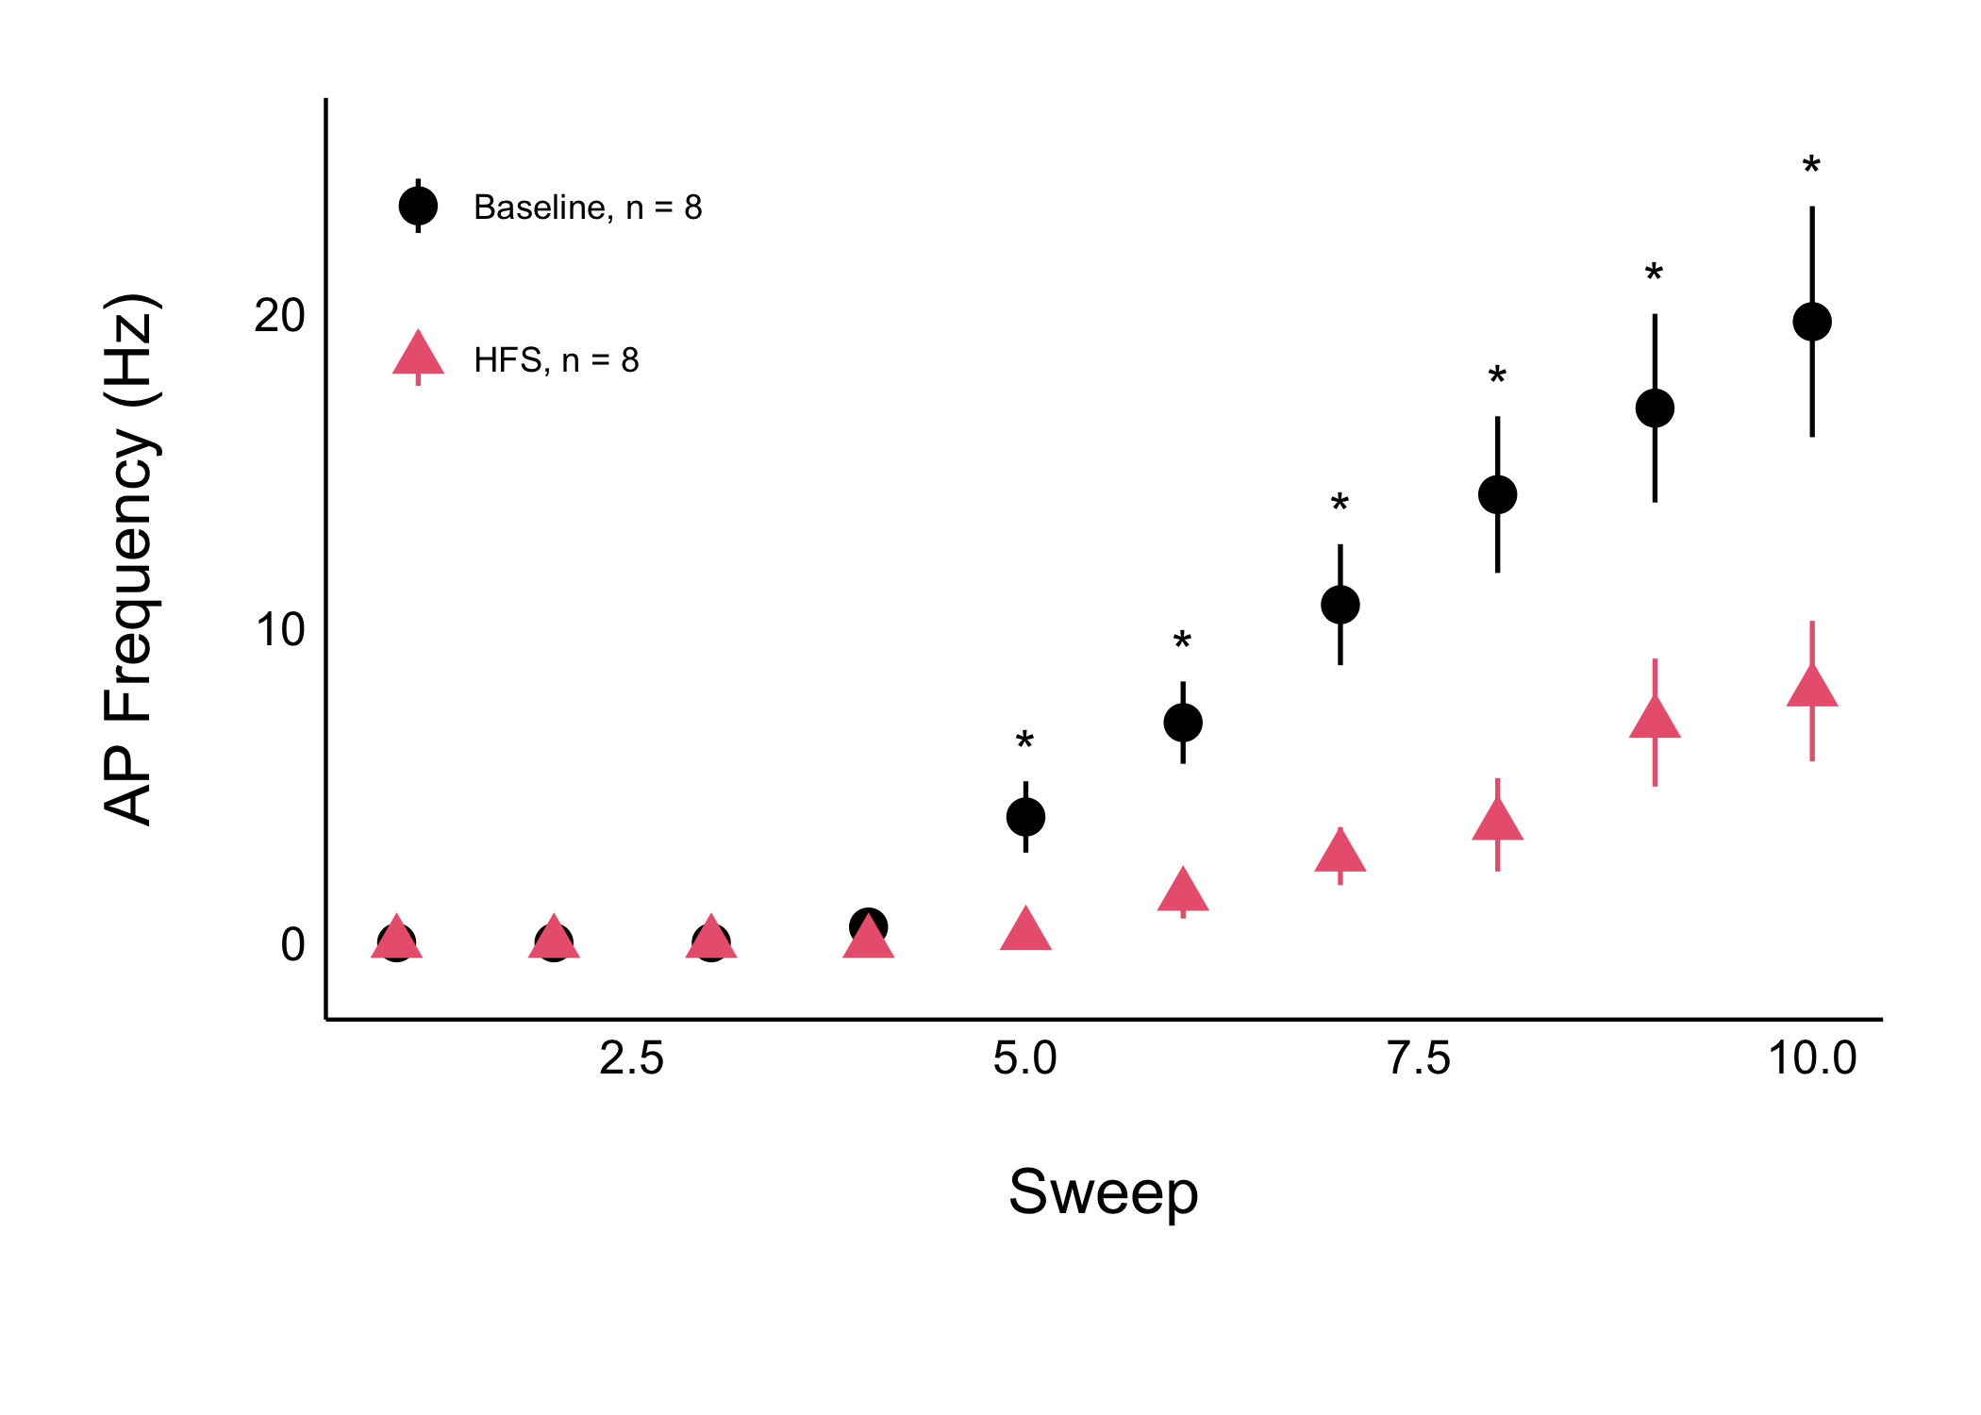
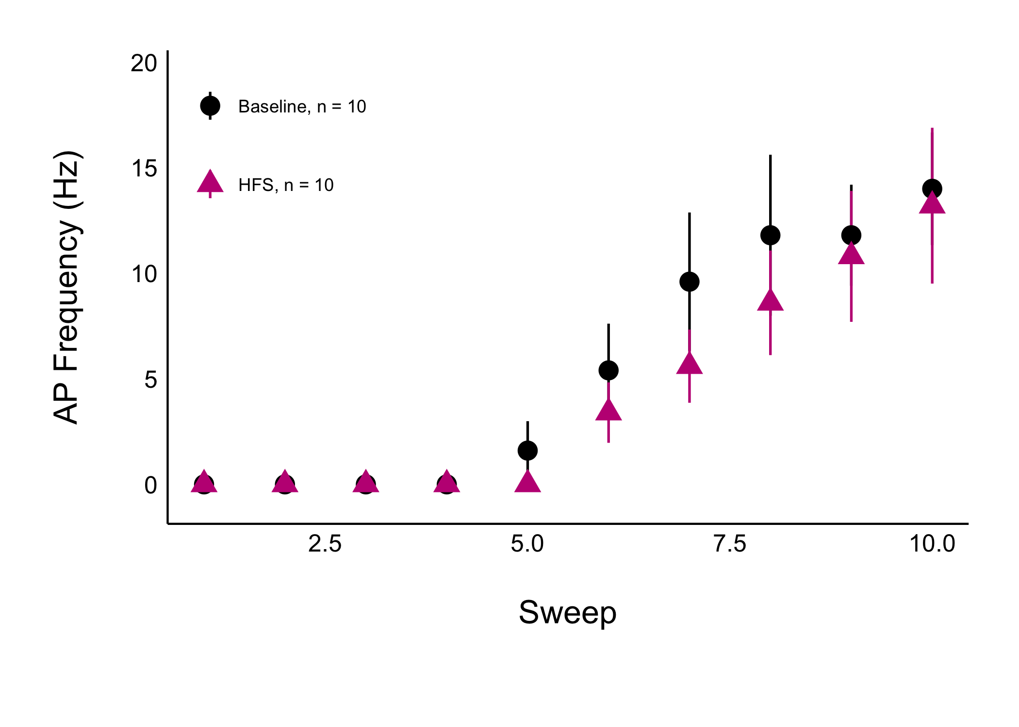
Acute Stress Decreases Neuronal Communication and Excitability in the Female Rat Dorsomedial Hypothalamus via Endocannabinoid-CB1 Receptor Signalling
Ruby Muzzatti, Dr Karen Crosby
Department of Biology, Mount Allison University, Sackville, New Brunswick, Canada
BACKGROUND
RESULTS
Acute stress significantly decreased the amplitude of evoked excitatory postsynaptic currents (eEPSC), but not when CB1 receptors were blocked
Naïve data was collected by Lara Swart. A paired t-test was used to compare each 5-minute interval to the 5-minute baseline period. * = p-value < 0.05, ** = p-value < 0.01
The paired pulse ratio (PPR) was significantly increased after HFS in acutely stressed neurons, but not when CB1 receptors were blocked
Action potential current amplitude and frequency was significantly decreased after HFS in acutely stressed neurons, but not when CB1 receptors were blocked
METHODS
All experiments were performed according to protocol #104140 approved by the
Mount Allison University Animal Care Committee in accordance with the
Canadian Council on Animal Care Guidelines
Young, female Sprague-Dawley rats were exposed to cold
They were anesthetized, euthanized, and their brains were quickly removed
Immediately following brain removal, a carotid blood sample was collected
An independent t-test was used to compare the baseline parameters of the naïve and cold groups
The PPR compares the amplitude of two evoked currents and is inversely proportional to the probability of neurotransmitter release
250 µm
coronal brain slices containing the DMH were kept alive in oxygenated artificial cerebrospinal fluid kept at 32.5 ℃
An independent t-test was used to compare the baseline parameters of the naïve and cold groups
A recording electrode was inserted into DMH neurons, and a stimulating electrode into the surrounding tissue to evoke excitatory postsynaptic currents (eEPSC)
50 µM picrotoxin was applied to observe glutamate synapses
CONCLUSIONS
Living neurons were recorded from
before and after high frequency stimulation (HFS)
Data analysis was performed using patchclampplotteR by Christelinda Laureijs⁶
100 Hz for 4 seconds, repeated twice, 20 seconds apart
Cold exposure does not affect baseline synaptic transmission in the DMH of female rats (unlike the cold-induced decrease observed in males)
Cold exposure triggers a long-lasting depression of glutamate synapses in the DMH (as was observed in males)
Future work aims to determine if:
The long-lasting depression is a result of the cold exposure or stress from the isolation, absence of bedding, and noise of the cold room (work in progress)
Brown adipose tissue activity is altered by cold exposure
REFRENCES
Schematic Images created using BioRender.
x
ACKNOWLEDGMENTS
NSERC USRA…
Notes:
Working titles: Acute Stress Decreases Neuronal Communication and Excitability in the Female Rat Dorsomedial Hypothalamus via Endocannabinoid-CB1 Receptor Signalling
The effect of acute stress on the probability of glutamate release after HFS is dependent on CB1Rs
Acute stress decreases AP peak amplitude after HFS depending on CB1Rs
Acute stress decreases AP frequency after HFS depending on CB1Rs

Slide 3
Acute Stress Decreases Neuronal Communication and Excitability in the Female Rat Dorsomedial Hypothalamus via Endocannabinoid-CB1 Receptor Signaling
Ruby Muzzatti, Dr Karen Crosby
Department of Biology, Mount Allison University, Sackville, New Brunswick, Canada
BACKGROUND
METHODS
250 µm
coronal brain slices containing the DMH were kept alive in oxygenated artificial cerebrospinal fluid kept at 32.5 ℃
A recording electrode was inserted into DMH neurons, and a stimulating electrode into the surrounding tissue to evoke excitatory postsynaptic currents (eEPSC)
50 µM picrotoxin was applied to observe glutamate synapses
Living neurons were recorded from
before and after high frequency stimulation (HFS)
Data analysis was performed using patchclampplotteR by Christelinda Laureijs⁶
100 Hz for 4 seconds, repeated twice, 20 seconds apart
RESULTS
CONCLUSIONS
Acute stress significantly decreased the amplitude of evoked excitatory postsynaptic currents (eEPSC), but not when CB1 receptors were blocked
The paired pulse ratio (PPR) was significantly increased after HFS in acutely stressed neurons, but not when CB1 receptors were blocked
Action potential current amplitude and frequency was significantly decreased after HFS in acutely stressed neurons, but not when CB1 receptors were blocked
Naïve data was collected by Lara Swart. A paired t-test was used to compare each 5-minute interval to the 5-minute baseline period. * = p-value < 0.05, ** = p-value < 0.01
The PPR compares the amplitude of two evoked currents and is inversely proportional to the probability of neurotransmitter release
An independent t-test was used to compare the baseline parameters of the naïve and cold groups
An independent t-test was used to compare the baseline parameters of the naïve and cold groups
REFRENCES
Schematic Images created using BioRender.
x
ACKNOWLEDGMENTS
NSERC USRA…
Notes:
Working titles: Acute Stress Decreases Neuronal Communication and Excitability in the Female Rat Dorsomedial Hypothalamus via Endocannabinoid-CB1 Receptor Signalling
The effect of acute stress on the probability of glutamate release after HFS is dependent on CB1Rs
Acute stress decreases AP peak amplitude after HFS depending on CB1Rs
Acute stress decreases AP frequency after HFS depending on CB1Rs

